Slide 1


Comprehensive analysis of linguistics factors impacting Language teaching and learning: from the Learner’s perspective
Indian Institute of Technology Guwahati
SHALU KUMARI, PROF. SUKUMAR NANDI AND PROF. BIDISHA SOM

Slide 4
Introduction
Research in teaching and learning of language has been an integral part of education.
Its journey has been long and fascinating, with variations in theoretical standpoints, methods in teaching and so on.
From Chomsky's “Generative Grammar approach”(1952)
to “Pragmatics” (Austin, 1962), “Communicative Competence” (Hymes, 1972)
to the most recent development “Cognitive Linguistics” (Sharwood, 1978)
Cognitive linguistics: usage-based approach, based on our experience of the world and the we perceive and conceptualize it.
Individuals are encouraged to learn a new language for several reasons:
Education, job, social mobility & to keep pace with the changes & developments around the globe.

Slide 5
Learner classification
Research in language teaching/learning has factored in many parameters
like age, input mechanism and their role in ultimate attainment &
some specific details of learners like motivation and social entrenchment, etc.
In today’s time, unsupervised, online learning environment demands customization of input as well.
This customization can be arrived at through a thorough knowledge of the learners’ background and utilizing the same to classify learners into categories.
A lesson plan built on this holistic approach will ensure higher success rate among students.

Slide 6
In the technology-driven world, language teaching and learning has reached the stage of stability, but the integration of learner specific study material needs to be considered.
For this purpose also, classification of learners is necessary.
In this regard, this work investigates linguistic correlates of language learner diversity i.e., important factors that influence new language learning.
Linguistics factors includes: learner’s language background, language usage pattern, parents' language background, community language use,
other factors like aptitude, motivation, cognitive style, attitudes, personality and extracurricular activities

Slide 7
The goal is to build a framework that identifies the types of learners based on their linguistics as well as non- linguistics factors .
Based on the literature survey, most used parameters for classification of the same are listed below:
Classification of learner can be primarily based on two sources of information: students’ language background information ; their level of English(target language) (Abedi, 2008)
The concept of learner classification is considered on learning behavior and performance. (Yathongchai (2013))
Proficiency levels at the different modalities also affects decisions on classifications. (Bunch (2006))

Slide 8
Parameters for learner classification (based on literature)
Learner
Student’s language background information (Abedi, 2008)
Level of (target language) proficiency (Abedi, 2008)
Learning behaviour (Yathongochai, 2013)
Proficiency level at different modalities (Bunch, 2006)
Learning profile (Yathongochai, 2013)
Motivation, attitude, age, intelligence, and personality (Khasinah, 2014)

Slide 9
Assumption:
Learner should at least know one language and can read, write and communicate in one language
Goal:
To empower the desire learner in their new language learning in a smooth and structured way.
To create learner specific lesson plan for better engagement.

Slide 10
Classification Model
The goal is to create a classification model.
As per our knowledge, there is no explicit classification model that exists in the language teaching and learning domain.
It is one of the major drawback of most of the Language Questionnaires, that they did not provide enough information for users of the questionnaire to definitively classify participants.
Researchers using these questionnaire are therefore required to determine their own methods for participant classification.

Slide 11
Classification of learner process
Data Collection
Data cleaning
Data transformation
Data normalization
Preprocessing
Applying Machine learning
PCA
K-means clustering
Elbow Curve
Clustering
Interpreting the results

Slide 12
Data collection
We developed a comprehensive questionnaire focusing on linguistic features pertinent to learner classification, as outlined earlier.
This questionnaire was administered to undergraduate students at IIT Guwahati.
Each participant was tasked with answering all questions included in the questionnaire.
In total, 340 students actively participated in the data collection process, contributing to the richness of our dataset.

Slide 13
Preprocessing
Data cleaning
Post-collection, the dataset underwent rigorous cleaning to ensure its quality and integrity.
Approximately 310 cleaned data entries were retained after the elimination of incomplete responses and those perceived as insincere.
Data transformation
The collected data, primarily in token form, underwent conversion into numerical values
to facilitate seamless utilization with machine learning techniques.
Data normalization
Given the diverse nature of the questions, ranging from two to five options, normalization was imperative to standardize the dataset's range uniformly.
Finally, the data was ready for integration into various machine learning techniques.

Slide 14
Applying Machine learning
Often in machine learning, the more features that are present in the dataset the better a classifier can learn.
However, more features also means a higher computational cost.
High dimensionality lead to long training times, algorithm overfitting.
Dimensionality reduction reduces the overall number of features, it can reduce the computational demands associated with training a model.
One of the primary algorithms used to carry out dimensionality reduction for unsupervised learning is Principal Component Analysis (PCA).

Slide 15
Principal Component Analysis (PCA)
PCA is a statistical method that creates new features or characteristics of data by analyzing the characteristics of the dataset.
Essentially, the characteristics of the data are summarized or combined together.
Since, we have an exhaustive questionnaire, with large number of features, we used PCA for dimensions reductionality.
It selects the "principal" or most influential characteristics of the dataset and creates features based on them.
We have 54 original features that was used for further processing.

Slide 16
After applying dimensions reductionality, it reduces the 54 features to 20 features.
PCA shows that the first 20 features are capturing around 80% of the variance.
So, we can replace 54 original features with the new 20 features having 80% of the information.
Although using 20 features could capture all the necessary information, we opted to focus on visualization by reducing dimensionality to just two features.
This deliberate choice enables more effective visualization of the data in two dimensions, enhancing our ability to discern patterns and relationships within the dataset.

Slide 17
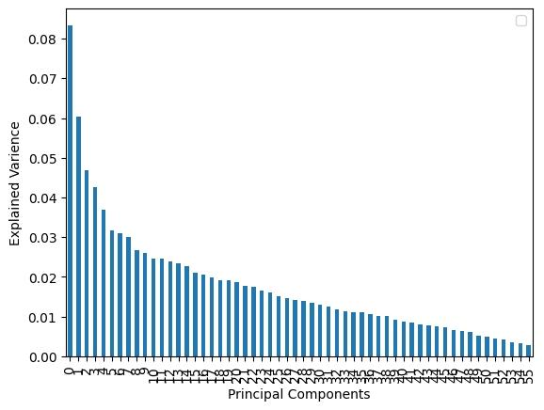
To visualise the data, we used the PCA function in the python to plot the bar graph in Fig. 1

Slide 18
K- Means Clustering
After reducing dimensionality with PCA, K-means clustering was applied to the processed data, focusing on the top two features that retained essential information.
K-means clustering is a technique used for partitioning data into distinct clusters based on similarity.
But , one of the key challenges for the K-means clustering is to determine the optimal number of clusters
Two approach to deal:
Manual investigation
Employ graphical tool elbow curve (it strikes a balance between capturing enough variance and avoiding overfitting)
So, for our dataset to get an optimal number of clusters, we plotted an elbow curve.
Where the no. of components or clusters at the elbow is considered the optimal choice.

Slide 19
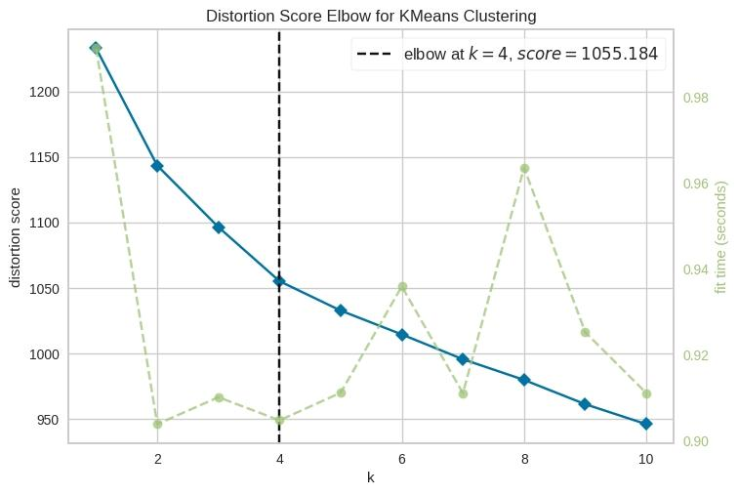
We found that 4 clusters are suitable for our dataset. The graph is shown in fig. 2.
X-axis : represent the number of clusters
Y-axis: evaluation metric.

Slide 20
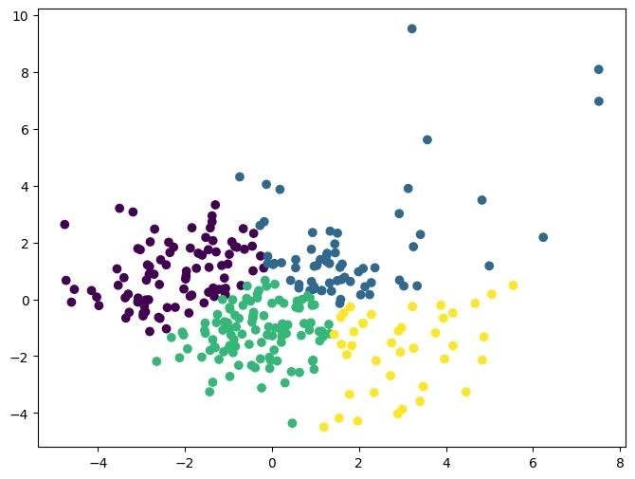
After determining the optimal number of clusters, we proceeded with the K-means clustering process.
This resulted in the dataset being partitioned into four distinct groups, with some outliers, as depicted in Figure 3.

Slide 21
Interpreting the results
Subsequently, we merged the labelled dataset obtained from the K-means processing with our original dataset, thereby establishing our four clusters.
These four groups are manually mapped with the classification of the learners where classification was manually done, based on the literature support & hence for now we have got our four categories.
These clusters corresponded to different levels of proficiency: novice, beginner, intermediate, and proficient,
Also, we are looking for more structured way of verifying these clusters or data validation.
.
(On – going work)

Slide 22
References:
Gambier, Y., & Gottlieb, H. (Eds.). (2001). Multidisciplinary Approaches to Discourse in Multimedia Communication. John Benjamins Publishing.
Markham, P., Peter, L., & McCarthy, M. (2001). The effects of native language subtitles on the viewing and listening comprehension of a foreign language film. Applied Linguistics, 22(2), 190-215.
Neves, J., & D'Ydewalle, G. (1987). Effects of subtitles on the vocabulary acquisition of children. Journal of Educational Psychology, 79(4), 492-496.
Román, P., Sorace, A., & Heywood, S. (2011). Factors influencing the effects of subtitles on foreign-language vocabulary learning. Language Learning, 61(4), 1052-1081.
Takac, V. P., & Robinson, D. H. (2017). Subtitles and listening comprehension: An empirical study. The Reading Matrix: An International Online Journal, 17(2), 100-115.

